Slide 1
SuperStore Sales Dashboard

Slide 2
About Superstore Sales Dataset:
Retail dataset of a global superstore for 4 years.
It consists of multiple columns including Profits,quantity,shipping cost,Sales and order dates etc.
Creating dashboard using multiple visuals highlight needed for business insights.

Slide 3
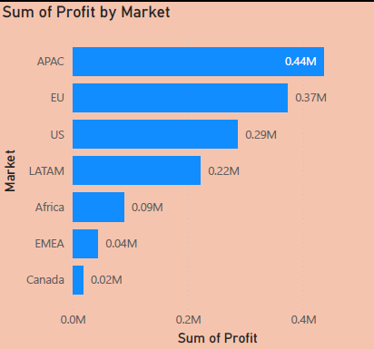
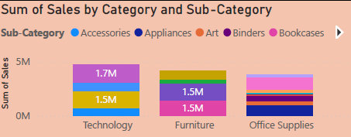
Column chart:
Bar chart,Pie chart or Stacked charts used for showing categorical comparisions.

Slide 4
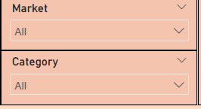
Slicer:
A slicer is an interactive filter in data visualization tools that allows users to dynamically refine and display specific data in dashboards.
Slicers used here as Dropdown and Tile .

Slide 5
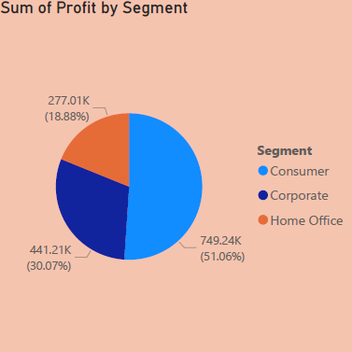
Pie Chart:
Visualizing the proportion of categories It shows how each category contributes to the total, as slices of a circle.

Slide 6
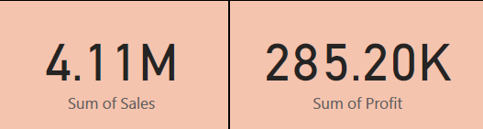
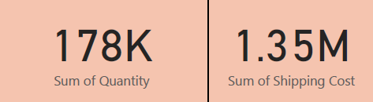
Card Visual:
a Card visual (often called a Text Card) is used to display a single number or text value.
It is useful when you want to highlight a key metric at a glance.

Slide 7
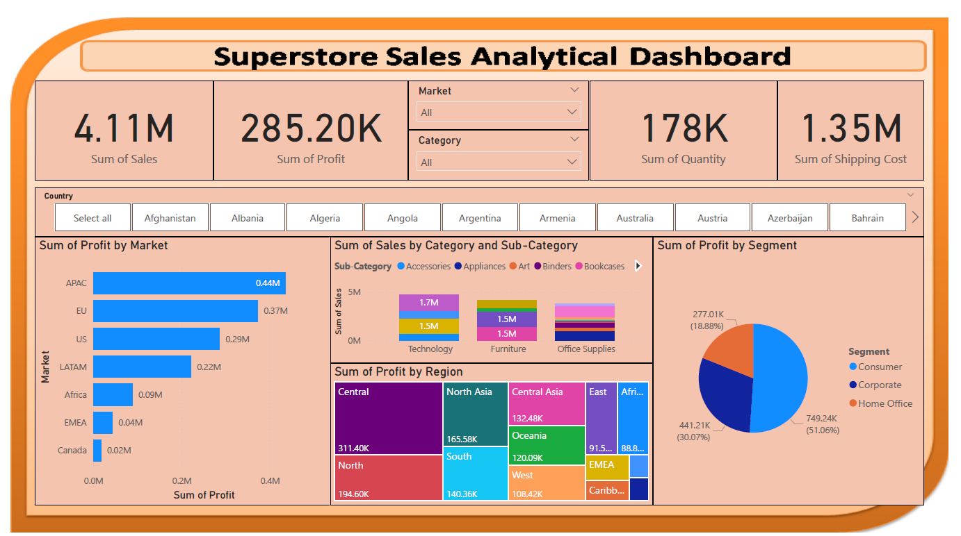
Superstore Sales Dashboard

Slide 8
Thank You

